Slide 1


Power generation on a x-minute precision (x ≈ 30) i.e. mean values of power very x min.
Simulation of 1-min variability using 1-min variability data
Evaluation of energy loss because of unexpected drops due to 1-min variability

Slide 2
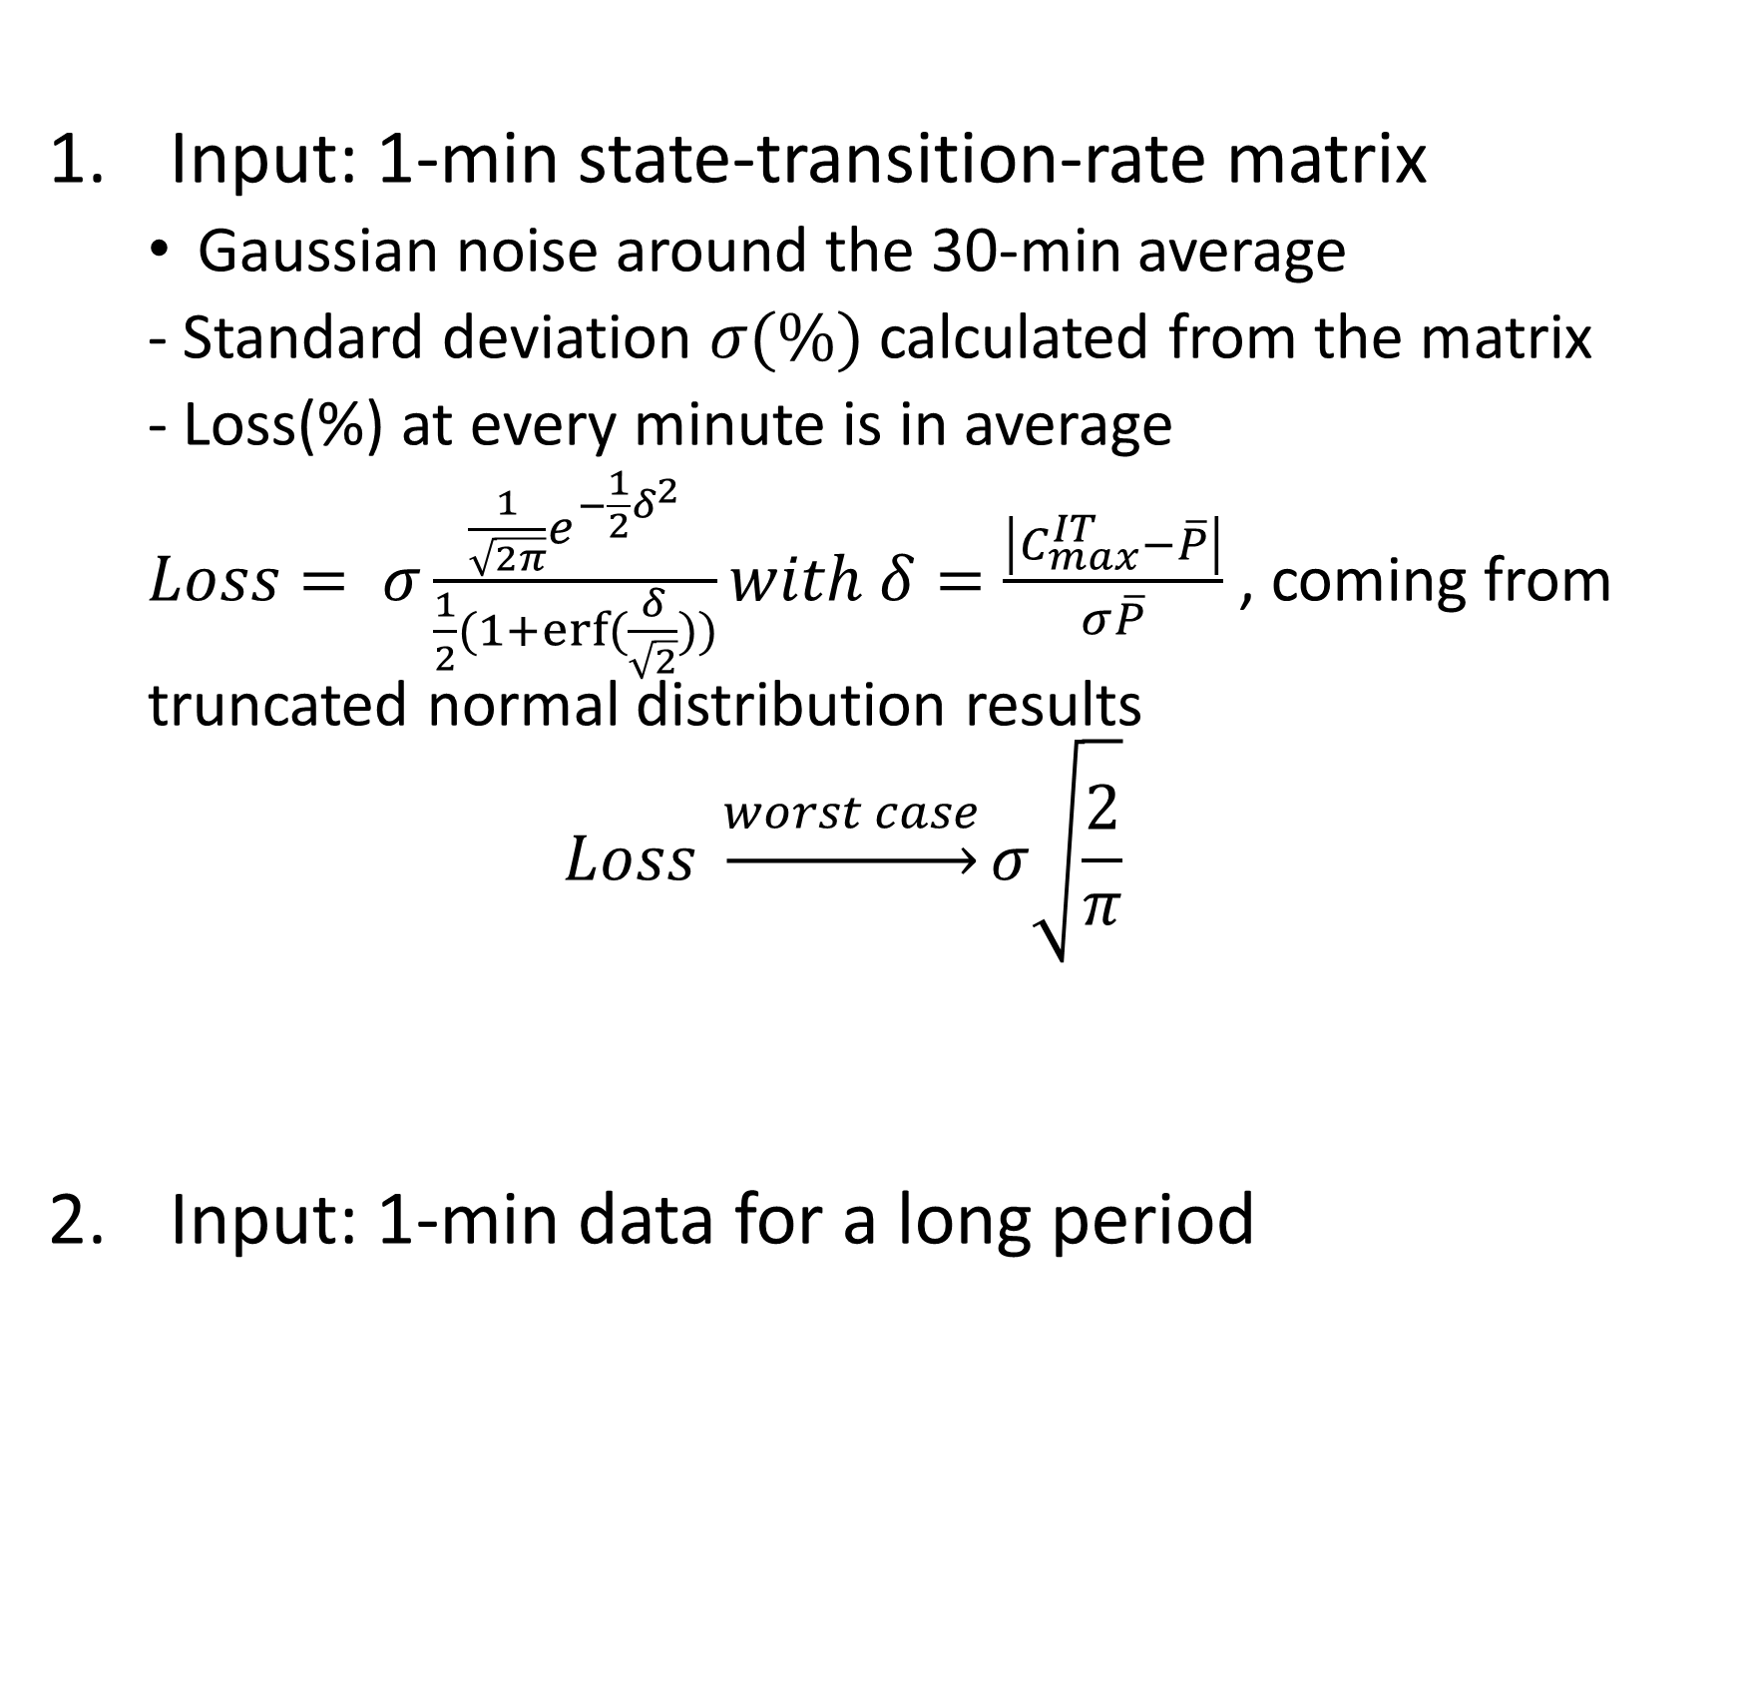
List of 1-min power variability simulation methods
Input: 1-min state-transition-rate matrix
Gaussian noise around the 30-min average
- Standard deviation $σ(\%)$ calculated from the matrix
- Loss(%) at every minute is in average
$Loss= σ\frac{\frac{1}{\sqrt{2π}}e^{−\frac{1}{2}δ^{2}}}{\frac{1}{2}(1+erf⁡(\frac{δ}{\sqrt{2}}))}with δ=\frac{\left|C_{max}^{IT}−\overline{P}\right|}{σ\overline{P}}$ , coming from truncated normal distribution results
$$Loss \underset{→}{worst case}σ\sqrt{\frac{2}{π}}$$
Input: 1-min data for a long period

